Slide 1
Managing Diversity Course Project
Stedroy Challanger
Keiser University
17/10/2021

Slide 2
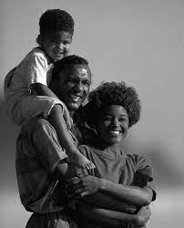
Introduction of Minority Group
A minority group refers to people whose practices, race, religion, ethnicity and other traits are fewer within a given country.
The minority groups tend to have fewer people as compared to the majority groups.
A certain majority groups within a certain place might be the majority group in other places.
The minority groups tend to be socially segregated from dominant forces in the society in multiple perspectives.
The choses minority groups in this presentation is the African Americans.
The Africans got to America during the era of slavery when they served labourers in different firms Whites.
Notes:
A minority group refers to people whose practices, race, religion, ethnicity and other traits are fewer within a given country. The minority groups tend to have fewer people as compared to the majority groups. A certain majority groups within a certain place might be the majority group in other places. The minority groups tend to be socially segregated from dominant forces in the society in multiple perspectives. The choses minority groups in this presentation is the African Americans. The Africans got to America during the era of slavery when they served labourers in different firms Whites.

Slide 3
Introduction of Minority Group
The culture of the African Americans is diverse from that of dominant groups and other minority groups.
The African Americans participated economic growth of America. Their culture is thus rooted in the historical experience they had in America (Polikoff & Lassar, 2020).
There were elaborate rituals and ceremonies among the African-Americans. This culture was borrowed from the West African Countries who traditionally believed in spirits surrounding nature.
The environment was treated with care among the-African Americans.
It is interesting how they believed in the existence of a higher power who gave and took life. Their god was worshipped through offering and there were ancestral spirits who acted and intermediaries.
Notes:
The culture of the African Americans is diverse from that of dominant groups and other minority groups. The African Americans participated economic growth of America. Their culture is thus rooted in the historical experience they had in America (Polikoff & Lassar, 2020). There were elaborate rituals and ceremonies among the African-Americans. This culture was borrowed from the West African Countries who traditionally believed in spirits surrounding nature. The environment was treated with care among the-African Americans. It is interesting how they believed in the existence of a higher power who gave and took life. Their god was worshipped through offering and there were ancestral spirits who acted and intermediaries.

Slide 4
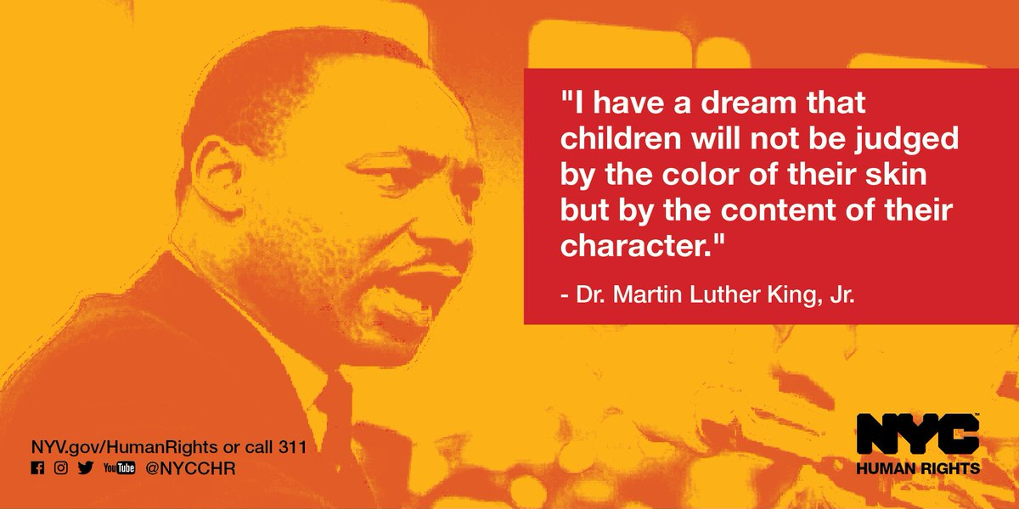
Key Facts
The Black Americans make about 13% of the US population
The Black population in the US has been growing significantly in the United State. In 2019, there were 46.8 million people who self-identified as Black, making up roughly 14% of the country's population. This marks a 29% increase since 2000, when there were roughly 36.2 million Black Americans.
Being among the minority groups, the Blacks have been subjected to different form of discrimination based on the race.
The Africans had prominent spokes persons like Martin Luther King who ended up being assassinated and they were following the rights of their people.
Notes:
The Black Americans make about 13% of the US population. The Black population in the US has been growing significantly in the United State. In 2019, there were 46.8 million people who self-identified as Black, making up roughly 14% of the country's population. This marks a 29% increase since 2000, when there were roughly 36.2 million Black Americans. Being among the minority groups, the Blacks have been subjected to different form of discrimination based on the race. The Africans had prominent spokes persons like Martin Luther King who ended up being assassinated and they were following the rights of their people.

Slide 5
Key Facts
In terms of healthcare, the African-Americans have been having poor access and the is due to costly medication.
The incidences of poverty are associated with their participation in criminal activities and some of them are homeless even to date.
Incidences of racial discrimination among the Blacks have been existing in the US and this can be confirmed by the killing and harassment of the Blacks by police.
Notes:
In terms of healthcare, the African-Americans have been having poor access and the is due to costly medication. The incidences of poverty are associated with their participation in criminal activities and some of them are homeless even to date. Incidences of racial discrimination among the Blacks have been existing in the US and this can be confirmed by the killing and harassment of the Blacks by police.

Slide 6
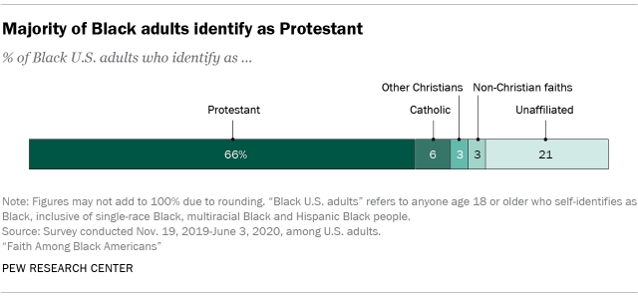
Key Facts
In the religious domain, most of the Black adults, approximately 66% are protestants, with about 21% unaffiliated by any particular religion, 6% Catholics, and 3% holding to non-Christian faiths.
The vast majority of the Black population as of 2019 speaks English very well or only speaks English at home 96%, while almost nine-in-ten 89% speak only English at home (Tamir et al., 2021).
Besides English, other languages spoken by the Black population ages 5 and older include Spanish 3%, French or Haitian Creole 2% and Amharic and other Ethiopian languages 1%.
In the education part, 23% of all Black adults ages 25 and older have a bachelor’s degree or more. A third 33% have completed some college as of 2019, and more than four-in-ten 44% have, at most, graduated from high school (Tamir et al., 2021).
Notes:
In the religious domain, most of the Black adults, approximately 66% are protestants, with about 21% unaffiliated by any particular religion, 6% Catholics, and 3% holding to non-Christian faiths (Tamir et al., 2021). The vast majority of the Black population as of 2019 speaks English very well or only speaks English at home 96%, while almost nine-in-ten 89% speak only English at home (Tamir et al., 2021). Besides English, other languages spoken by the Black population ages 5 and older include Spanish 3%, French or Haitian Creole 2% and Amharic and other Ethiopian languages 1%. In the education part, 23% of all Black adults ages 25 and older have a bachelor’s degree or more. A third 33% have completed some college as of 2019, and more than four-in-ten 44% have, at most, graduated from high school

Slide 7
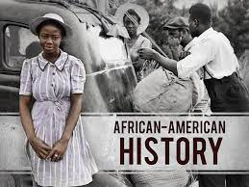
History of the African Americans in the U.S
The Africans worked with the Spanish and the Portuguese in their early exploration of America.
In the 16th century, a few Black explorers settled in the area around Mississippi valley.
In the 17th century, the Blacks were taken as slaves to provided free labour to their masters in part of Virginia (Polikoff & Lassar, 2020).
Approximately 430,000 Africans Americans came to the US through enslavement and majority of them were taken from Western African countries.
The skin color of Blacks is much different from that of the Native Americans and thus they were easily distinguished.
Notes:
The Africans worked with the Spanish and the Portuguese in their early exploration of America. In the 16th century, a few Black explorers settled in the area around Mississippi valley. In the 17th century, the Blacks were taken as slaves to provided free labour to their masters in part of Virginia. Approximately 430,000 Africans Americans came to the US through enslavement and majority of them were taken from Western African countries (Polikoff & Lassar, 2020). The skin color of Blacks is much different from that of the Native Americans and thus they were easily distinguished.

Slide 8
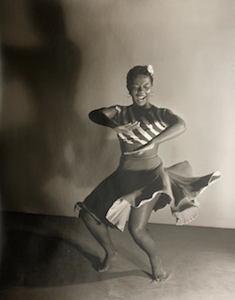
History of the African Americans in the U.S
There is and saying developed that “the history of African-Americans in the history of America.”
This saying is based on the fact that the fast growth of American was based on services of the Blacks, especially through labor.
The Blacks were significant in the development of Southern Speech, folklore, dances, music and food and this was blended with that of Native-Americans (Polikoff & Lassar, 2020).
Overtime changes happened and slave trade was abolished followed by slavery. This was ended after the bloodiest Civil War.
Since 1870, when Senator Hiram Revels of Mississippi and Representative Joseph Rainey of South Carolina became the first African Americans to serve in Congress, a total of 173 African Americans have served as U.S. Representatives, Delegates, or Senators.
Notes:
There is and saying developed that “the history of African-Americans in the history of America.” This saying is based on the fact that the fast growth of American was based on services of the Blacks, especially through labor (Polikoff & Lassar, 2020). The Blacks were significant in the development of Southern Speech, folklore, dances, music and food and this was blended with that of Native-Americans. Overtime changes happened and slave trade was abolished followed by slavery. This was ended after the bloodiest Civil War (Polikoff & Lassar, 2020). Since 1870, when Senator Hiram Revels of Mississippi and Representative Joseph Rainey of South Carolina became the first African Americans to serve in Congress, a total of 173 African Americans have served as U.S. Representatives, Delegates, or Senators.

Slide 9
Relevant Legislations
The initial legislations in relation to the African Americans were focused on the elimination of slavery.
In 1807 President Thomas Jefferson signed legislation that was intended to eliminate slave trade and this was the beginning of domestic slave trade among the people of U.S. (Stooksbury et al., 2017).
The laws referred to as slave codes were looked upon to regulate the slave systems and promoted absolute control by their masters with total submission by the slave.
The slave codes prevented the Africans from learning to read or write and allowed corporal punishment by their masters (Stooksbury et al., 2017).
The Second Morrill Act of 1980 allowed the Blacks to acquired education, even higher education with public support.
Notes:
The initial legislations in relation to the African Americans were focused on the elimination of slavery. In 1807 President Thomas Jefferson signed legislation that was intended to eliminate slave trade and this was the beginning of domestic slave trade among the people of U.S. (Stooksbury et al., 2017). The laws referred to as slave codes were looked upon to regulate the slave systems and promoted absolute control by their masters with total submission by the slave. The slave codes prevented the Africans from learning to read or write and allowed corporal punishment by their masters (Stooksbury et al., 2017). The Second Morrill Act of 180 allowed the Blacks to acquired education, even higher education with public support.

Slide 10
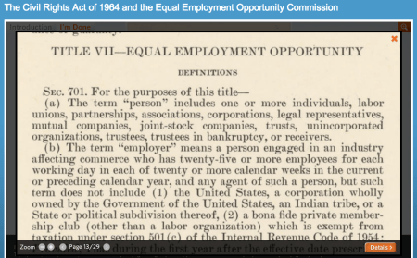
Relevant Legislations
The Civil Rights Act of 1865 was mainly intended, in the wake of the American Civil War, to protect the civil rights of persons of African descent born in or brought to the United States (Stooksbury et al., 2017).
The Civil Rights Act of 1875 was aimed at protecting African American from deprivation of the minimal rights of citizenship.
The Voting Rights Act of 1965 outlawed all discriminatory in voting practices all across the USA.
The most significant legislation in African American history that is much applicable even in the modern days is Article VII of 1964 that warns against all forms of employee discrimination based on race, gender or religion (Stooksbury et al., 2017).
Notes:
The Civil Rights Act of 1865 was mainly intended, in the wake of the American Civil War, to protect the civil rights of persons of African descent born in or brought to the United States. The Civil Rights Act of 1875 was aimed at protecting African American from deprivation of the minimal rights of citizenship. The Voting Rights Act of 1965 outlawed all discriminatory in voting practices all across the USA. The most significant legislation in African American history that is much applicable even in the modern days is Article VII of 1964 that warns against all forms of employee discrimination based on race, gender or religion.

Slide 11
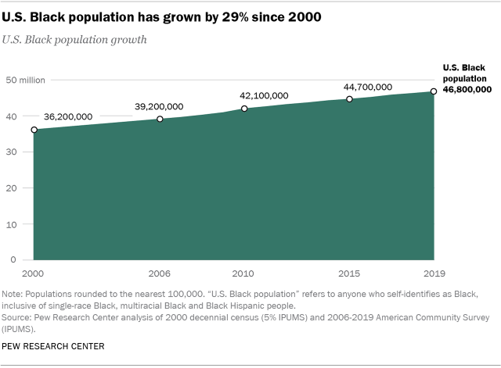
Population of African Americans
The population of Blacks in US was 46.8 million people in 2019.
In 2000, the Black population was roughly 36.2 million people and this implies that it is the fastest growing population in the U.S (Tamir et al., 2021).
The increase over the two decades amounts to about 29% and this is a high rate.
At least 4.6 million Blacks were outside U.S. and this amount to 10% of the Black foreign population.
Over the last 2 decades, there have been a significant increase in the number of Black foreign population by approximately 7% (Tamir et al., 2021).
Notes:
The population of Blacks in US was 46.8 million people in 2019. In 2000, the Black population was roughly 36.2 million people and this implies that it is the fastest growing population in the U.S. The increase over the two decades amounts to about 29% and this is a high rate (Tamir et al., 2021). At least 4.6 million Blacks were outside U.S. and this amount to 10% of the Black foreign population. Over the last 2 decades, there have been a significant increase in the number of Black foreign population by approximately 7%.

Slide 12
Population of African Americans
The U.S. Black population is young and increasing. The median age of Black people in 2019 was 32, six years younger than the U.S. population’s median age of 38.
About 30% of the whole Black population was under the age of 20 and 11% were 65 or older.
At least a third of the U.S. Black population 35% was 22 years or younger in 2019 (Tamir et al., 2021).
An extra 23% were Millennials, implying that about 58% of all Black Americans were age 38 or younger in 2019.
The overall fertility rate among Black women ages 15 to 44 is 5.9%.
Notes:
The U.S. Black population is young and increasing. The median age of Black people in 2019 was 32, six years younger than the U.S. population’s median age of 38 (Tamir et al., 2021). About 30% of the whole Black population was under the age of 20 and 11% were 65 or older. At least a third of the U.S. Black population 35% was 22 years or younger in 2019. An extra 23% were Millennials, implying that about 58% of all Black Americans were age 38 or younger in 2019. The overall fertility rate among Black women ages 15 to 44 is 5.9%.

Slide 13
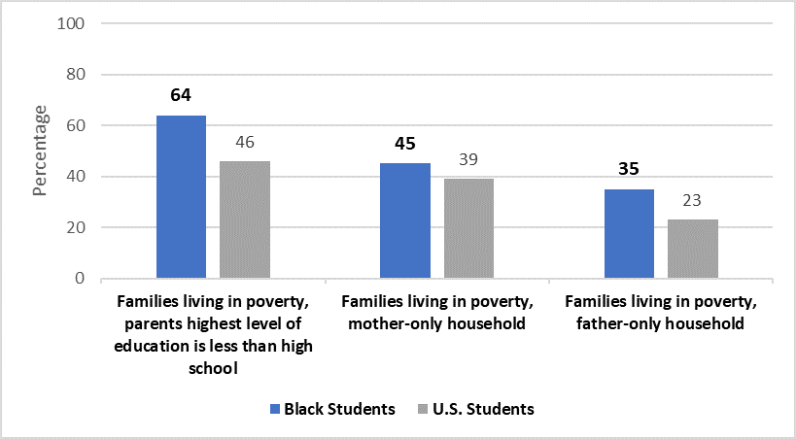
Education, Employment, and Earnings
Education
In the last decade, the school dropout rates of the African Americans were high.
Poverty is the primary cause of school dropout among the Blacks in America.
In 2018, about 32%, a third of Black students lived in poverty, compared with 10% of white students in families living in poverty (Tamir et al., 2021).
The fraction of Black students who lived in families where the highest level of education accomplished by either parent was a bachelor’s or higher degree was 27%, compared with 69% of Asian students and 53% of white students.
Notes:
Nearly a quarter 23% of all Black adults ages 25 and older have a bachelor’s degree or more. A third 33% have finished some college as of 2019, and more than four-in-ten 44% have, at most, graduated from high school. In the last decade, the school dropout rates of the African Americans were high. Poverty is the primary cause of school dropout among the Blacks in America (Tamir et al., 2021). In 2018, about 32%, a third of Black students lived in poverty, compared with 10% of white students in families living in poverty. The fraction of Black students who lived in families where the highest level of education accomplished by either parent was a bachelor’s or higher degree was 27%, compared with 69% of Asian students and 53% of white students.

Slide 14
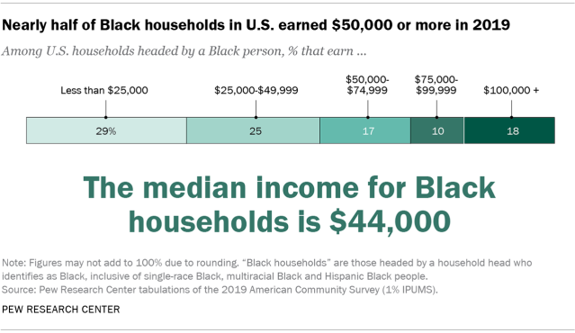
Employment and Earnings
Jobs are necessary for fighting poverty among Black Americans.
The Blacks’ unemployment rate has fallen in the recent past from about 16.6% in 2020 to about 13.2% by the start of 2021 (Tamir et al., 2021).
African Americans have consistently shown an unemployment rate double that of whites.
The median household income for Black homes in 2019 was $44,000, and this implies that half of households headed by a Black person earn more than that and half earn less.
Wider examination displays that more than half, 54% of Black households earn less than $50,000, while 46% make $50,000 or more (Tamir et al., 2021). Almost three-in-ten 28% make $75,000 or more, plus 18% that earn $100,000 or extra.
Notes:
Jobs are necessary for fighting poverty among Black Americans. The Blacks’ unemployment rate has fallen in the recent past from about 16.6% in 2020 to about 13.2% by the start of 2021 (Tamir et al., 2021). African Americans have consistently shown an unemployment rate double that of whites. The median household income for Black homes in 2019 was $44,000, and this implies that half of households headed by a Black person earn more than that and half earn less. Wider examination displays that more than half, 54% of Black households earn less than $50,000, while 46% make $50,000 or more (Tamir et al., 2021). Almost three-in-ten 28% make $75,000 or more, plus 18% that earn $100,000 or extra.

Slide 15
Stereotypes Associated with African Americans
The common stereotypes on African American was brought about by theatrical stage with the advent of the blackface minstrel.
In the early 19th century some white actors darkened their face to look like the Africans and were involved in acting the vices roles (Whaley, 2018).
Movies have been passing a couple of stereotypes against the Blacks like “The Slave” in 1905 in which the Africans were treated as savage (Whaley, 2018).
The whites believed that Blacks did not need education and they were mentally inferior, physically and culturally unevolved, and apelike in appearance.
Notes:
The common stereotypes on African American was brought about by theatrical stage with the advent of the blackface minstrel. In the early 19th century some white actors darkened their face to look like the Africans and were involved in acting the vices roles. Movies have been passing a couple of stereotypes against the Blacks like “The Slave” in 1905 in which the Africans were treated as savage (Whaley, 2018). The whites believed that Blacks did not need education and they were mentally inferior, physically and culturally unevolved, and apelike in appearance

Slide 16
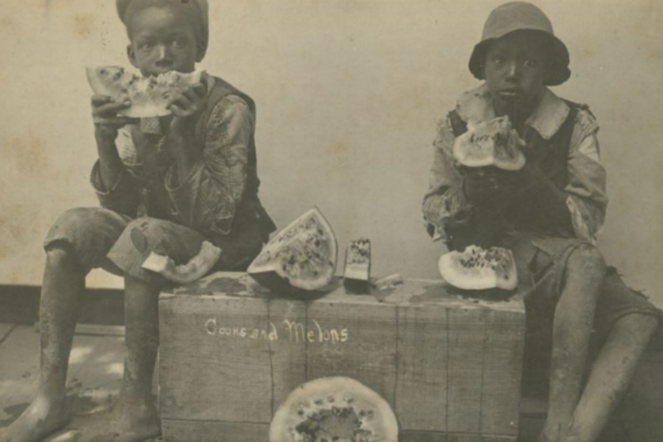
Stereotypes Associated with African Americans
The African Americans were referred to “Zip coon” and this is a lithograph depicting the knocking of a pig (Whaley, 2018).
There was a picture circulated of a boy eating a slice of watermelon and this was and implication of poverty among the minority group.
The African were thought to be far less sensitive to pain than the whites. This was applied in childbirth where women were thought to experience less pain than whites and this as based on “The Africans bear cutting with nearly...as much impunity as dogs and rabbits" (Whaley, 2018).
Notes:
The African Americans were referred to “Zip coon” and this is a lithograph depicting the knocking of a pig (Whaley, 2018). There was a picture circulated of a boy eating a slice of watermelon and this was and implication of poverty among the minority group. The African were thought to be far less sensitive to pain than the whites. This was applied in childbirth where women were thought to experience less pain than whites and this as based on “The Africans bear cutting with nearly...as much impunity as dogs and rabbits" (Whaley, 2018).

Slide 17
Strengths of African Americans
The African Americans are known for their strong bodies and are capable of participating in high energy involving activities.
The skin complexion of Blacks acts as a protection against the sun rays and thus they are less affected by hot sun rays as compared to the Whites.
The fertility rates of the Blacks are higher than that other races. Averagely, the Black woman can give birth to about five children in their life and is exemptional as compared to the averages world fertility rates at 2.5 children throughout the reproductive age (Kelly, 2019).
Notes:
The African Americans are known for their strong bodies and are capable of participating in high energy involving activities. The skin complexion of Blacks acts as a protection against the sun rays and thus they are less affected by hot sun rays as compared to the Whites. The fertility rates of the Blacks are higher than that other races. Averagely, the Black woman can give birth to about five children in their life and is exemptional as compared to the averages world fertility rates at 2.5 children throughout the reproductive age (Kelly, 2019).

Slide 18
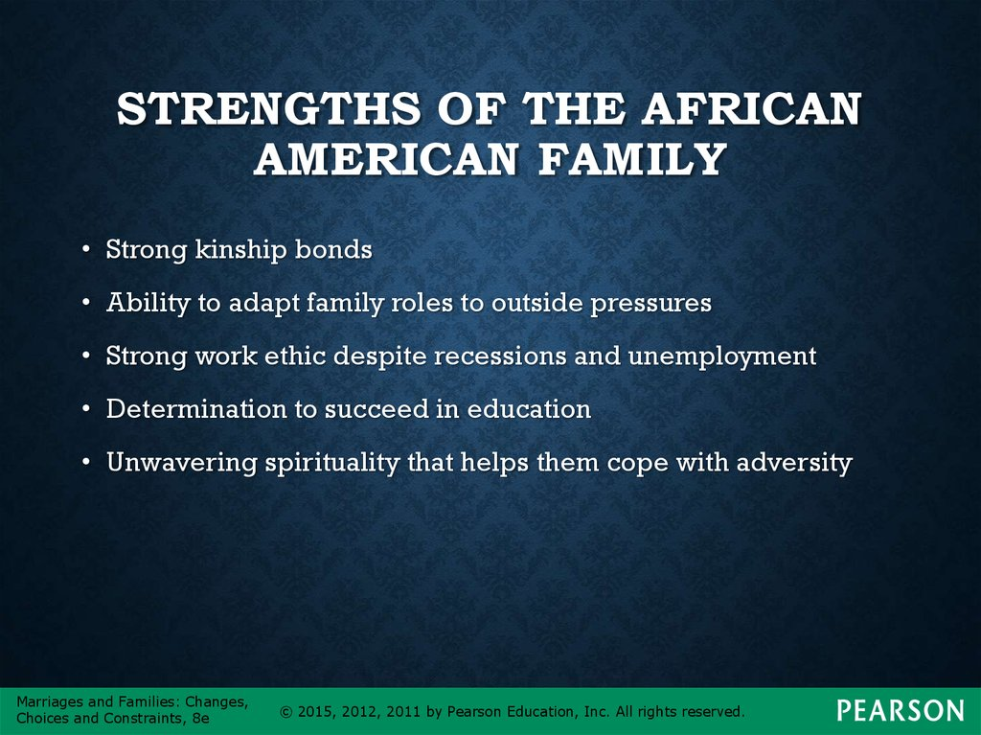
Strengths of African Americans
The African Americans have been stronger immunity level and compared to the Whites in regard to some infections. However, all races are equally susceptible to COVID-19.
The African Americans have strong kinship bonds and this as necessitated by the need for unity to success in the racially discriminative society (Kelly, 2019).
In addition, they have strong achievement orientations despite the challenging racial discriminations in their settings (Kelly, 2019).
Lastly, they have strong religious orientations and hold faith in God as most of them a Christians.
Notes:
The African Americans have been stronger immunity level and compared to the Whites in regard to some infections. However, all races are equally susceptible to COVID-19. The African Americans have strong kinship bonds and this as necessitated by the need for unity to success in the racially discriminative society (Kelly, 2019). In addition, they have strong achievement orientations despite the challenging racial discriminations in their settings. Lastly, they have strong religious orientations and hold faith in God as most of them a Christians.

Slide 19
Reflection
All the races in the world have established culture that determine their ways of life.
The African-Americans had culture that was based on their West African Culture and in this case, they believed in ancestral spirits and worshiped their god through them.
The current discrimination against the Blacks is due to stereotypes attached to the members of minority group.
Slavery and slave trade played a bigger role for the Africans to land in America and they were discriminated by other groups racially due to their skin color and practices.
The African Americans are hardworking and they are always committed to solving the existing poverty issues and thus they provide quality services.
Notes:
All the races in the world have established culture that determine their ways of life. The African-Americans had culture that was based on their West African Culture and in this case, they believed in ancestral spirits and worshiped their god through them. The current discrimination against the Blacks is due to stereotypes attached to the members of minority group. Slavery and slave trade played a bigger role for the Africans to land in America and they were discriminated by other groups racially due to their skin color and practices. The African Americans are hardworking and they are always committed to solving the existing poverty issues and thus they provide quality services.

Slide 20
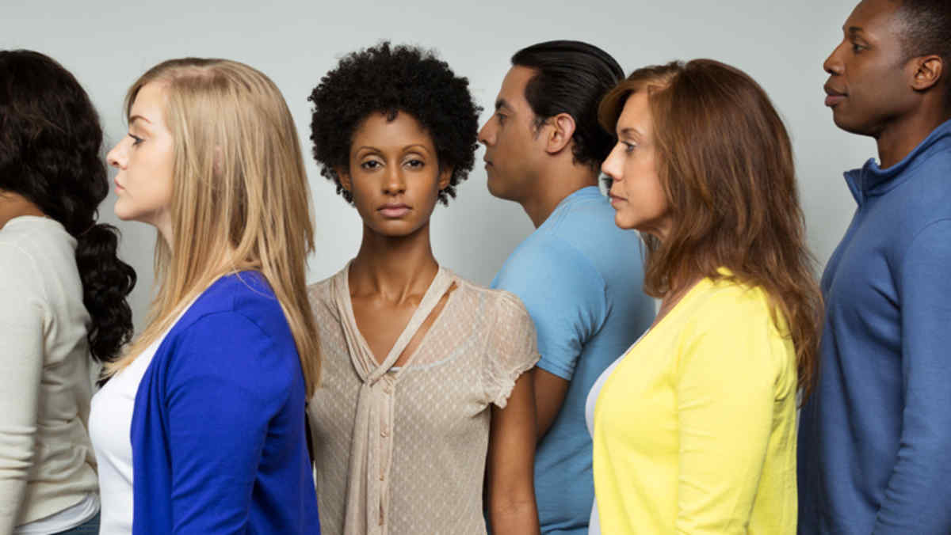
Reflection
African Americans have had a rough history and they have managed to survive through and thus need chances to offer their services in organizations.
There is need to eliminate all forms of discrimination in the workplaces as per the Article VII of the U.S. constitution.
There are policies warning the employers against discriminating the minority group and thus observing them is recommendable.’
Stereotypes on the African Americans affect their morale and ability to provide quality services and thus should be avoided.
Notes:
African Americans have had a rough history and they have managed to survive through and thus need chances to offer their services in organizations. There is need to eliminate all forms of discrimination in the workplaces as per the Article VII of the U.S. constitution. There are policies warning the employers against discriminating the minority group and thus observing them is recommendable. Stereotypes on the African Americans affect their morale and ability to provide quality services and thus should be avoided.

Slide 21
References
Kelly, S. (2019). Cognitive behavior therapy with African Americans.
Polikoff, A., & Lassar, E. (2020). A Brief History of the Subordination of African Americans in the US: Of Handcuffs and Bootstraps. Routledge.
Stooksbury, K. E., Scheb II, J. M., & Stephens Jr, O. H. (Eds.). (2017). Encyclopedia of American Civil Rights and Liberties: Revised and Expanded Edition, [4 volumes]. ABC-CLIO.
Tami. C., Budiman. A., & Mora. L., (2021). Facts About the U.S. Black Population. Retrieved from https://www.pewresearch.org/social-trends/fact-sheet/facts-about-the-us-black-population/#household-income
Whaley, A. L. (2018). Advances in stereotype threat research on African Americans: Continuing challenges to the validity of its role in the achievement gap. Social Psychology of Education, 21(1), 111-137.

